Slide 1
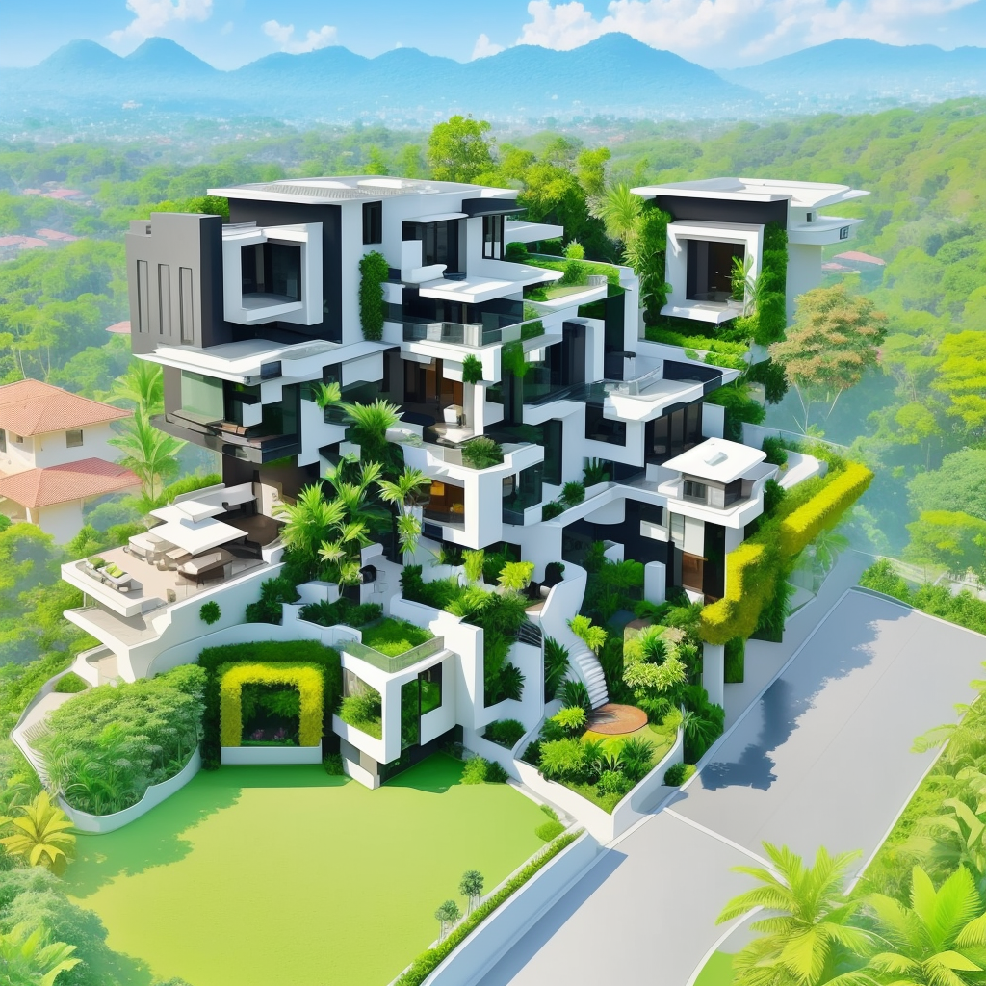

TNSDC
GENERATIVE AI FOR ENGINEERING
FINAL PROJECT
SUBMITTED BY:
SELVAKUMAR P
(311521104052)

Slide 2
QR-CODE GENERATION
Using - GENERATIVE AI

Slide 3

AGENDA
INTRODUCTION
Background
Generative AI Techniques for QR Code Generation
Advantages of Using Generative AI for QR Code Generation
Challenges and Considerations
Future Prospects and Research Directions
Conclusion

Slide 4

INTRODUCTION
The emergence of artificial intelligence (AI) has revolutionized various domains, including QR code generation .
QR codes have become an integral part of modern society, facilitating efficient data encoding and decoding across various industries such as marketing, logistics, and authentication. These two-dimensional barcodes offer a versatile means of transmitting information rapidly and conveniently.
Generative AI techniques, such as Generative Adversarial Networks (GANs) and Variational Autoencoders (VAEs), offer promising solutions to enhance QR code generation by enabling dynamic, customizable, and visually appealing designs.

Slide 5
BACKGROUND
Traditional QR code generation methods involve encoding data into a grid of black and white squares, resulting in static, monochromatic patterns.
Static QR codes have limitations in terms of design flexibility, customization, and visual appeal, which may hinder user engagement and adoption.
Generative AI, a subset of artificial intelligence, focuses on generating new data that mimics existing data distributions, offering potential solutions to overcome the limitations of traditional QR code generation.

Slide 6

Generative AI Techniques
GANs are deep learning models consisting of two neural networks: a generator and a discriminator. The generator generates new data samples, while the discriminator distinguishes between real and generated samples. Through adversarial training, GANs learn to generate realistic and diverse data.
VAEs are probabilistic models that learn to encode and decode data into a latent space. By sampling from the latent space, VAEs can generate new data samples that resemble the original data distribution while allowing for interpolation and exploration of latent features.
QR CODE GENERATION

Slide 7
Advantages of Using Gen- AI for QR Code Generation
Enhanced Visual Aesthetics : Generative AI techniques allow for the generation of visually appealing QR code designs with intricate patterns, colors, and textures, enhancing user engagement and brand recognition.
Customization Options : Generative AI enables the customization of QR codes based on user preferences, allowing for personalized designs tailored to specific applications or contexts.
Dynamic QR Code Generation: Generative AI techniques enable the generation of dynamic QR codes that can adapt and evolve over time, providing real-time updates or interactive experiences for users.

Slide 8
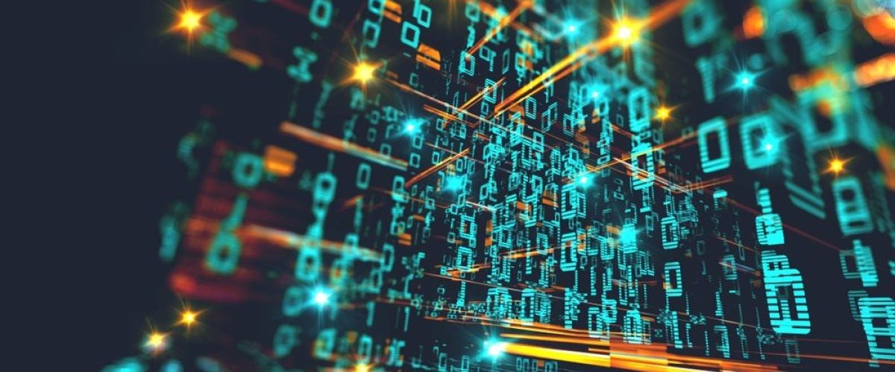
Challenges and Considerations
Data Quality and Availability : Generative AI models require large amounts of high-quality training data to learn meaningful representations. Obtaining diverse and representative QR code datasets may pose challenges in certain domains.
Computational Complexity : Training and deploying generative AI models can be computationally intensive, requiring significant computational resources and infrastructure.
QR Code Scannability : While visually appealing designs are desirable, it is essential to ensure that generated QR codes remain scannable and reliable across different scanning devices and environments.
QR CODE GENERATION

Slide 9
Future Prospects and Research Directions
RESEARCH DIRECTIONS
Future research in the field of QR code generation using generative AI may focus on addressing several key challenges and exploring new avenues for advancement.
One research direction involves improving the quality of training data to ensure that generative AI models can effectively learn diverse QR code patterns and designs.
Additionally, optimizing model performance and scalability is essential for deploying generative AI algorithms in real-world applications, particularly in scenarios requiring rapid QR code generation at scale.
Furthermore, exploring novel generative AI architectures tailored specifically to QR code generation could lead to breakthroughs in design creativity, scanability, and usability.

Slide 10
Future Prospects and Research Directions
INTERDISCIPLINARY COLLABORATION
Interdisciplinary collaboration between researchers in computer vision, machine learning, and graphic design fields is crucial for driving innovation in QR code generation.By leveraging expertise from diverse domains, interdisciplinary teams can develop holistic approaches to address complex challenges and unlock new possibilities for QR code technology.
For example, collaboration between computer vision researchers and graphic designers can lead to the development of novel techniques for generating QR codes with optimized visual aesthetics and scanability.
Similarly, partnerships between machine learning experts and marketing professionals can enable the creation of QR code generation platforms tailored to specific marketing objectives and target audiences. Overall, interdisciplinary collaboration fosters innovation and accelerates the advancement of QR code technology.

Slide 11
CONCLUSION
In conclusion, the integration of generative AI techniques offers significant opportunities for revolutionizing QR code generation. By harnessing the power of GANs, VAEs, and other generative AI algorithms,
QR codes can be transformed into dynamic, customizable, and visually appealing assets with enhanced functionality and user engagement. While challenges remain, continued research, interdisciplinary collaboration, and innovation hold the key to unlocking the full potential of QR code technology in the digital age.
Summarize the key findings and outcomes of the project, highlighting the success of using generative AI for QR code generation.
Reflect on the project's contributions to the field of QR code technology and the broader implications for information encoding and communication.

Slide 12

T H A N K Y O U

